Slide 1
Auburn-USDA CS Clinic
Liaison Meeting (2/6/25)

Slide 2
Publication
What is our role?
Specifically, we want to know what tasks we should start on.
What is the scope of the publication?
Specifically, is the focus of this publication our methods? Will we be writing about the software?

Slide 3
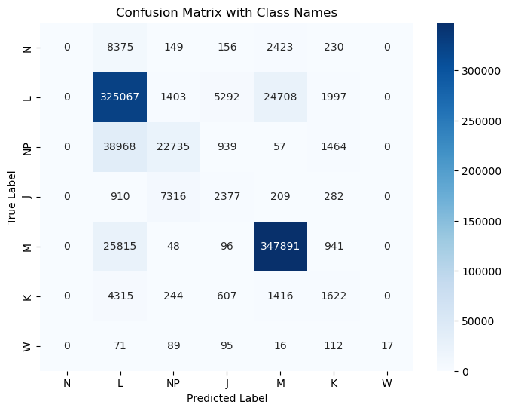
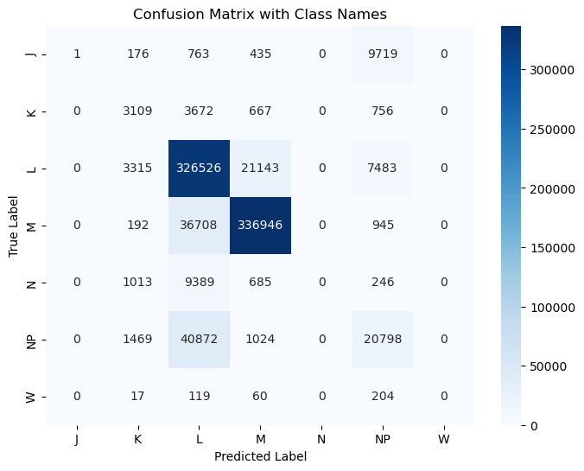
ClaSP Integration
Almost the same as without
L: voltage only, R: voltage + ClaSP

Slide 4
GUI Progress (A Super Quick Demo)

Slide 5
Conditional Random Fields (CRF)
Our current methods do a decent job of predicting what label each time step is while taking into account the context of each label, but they do not have any rigid rules that penalize impossible transitions
CRFs can be thought of as a post-processing layer which let us penalize our models for using impossible transitions and encourage proper transitions.
More concretely, given the outputs from a previous model (like one of the CNNs), CRFs find the best prediction that also follows known transition rules
Ex:
Model thinks it is very likely that the sequence goes NP-NP-L-L
CRF can correct the model by telling it that such a sequence is impossible
Model retrains, hopefully outputs something more reasonable like NP-J-K-L

Slide 6
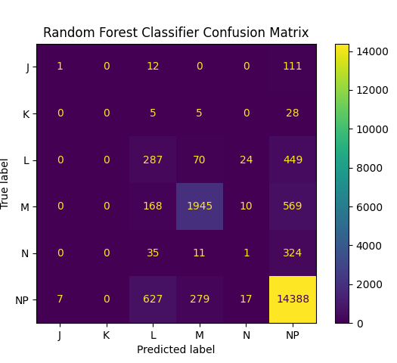
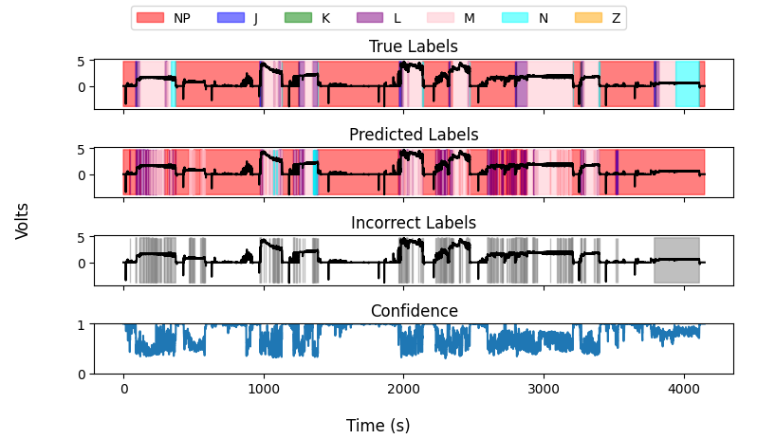
Aedes aegypti random forests
Model performance similar to tarsalis, accuracy ~85%
Similar barcoding issues

Slide 7
HMM Progress
Explored parameters used for hidden Markov model
Trained on flattened tarsalis voltage, resistance, post_rect, and labels
Better convergence than previously thought. Verification underway
Optimization (current task)
Model divergence: Sensitive to covariance selection and number of expected hidden states
Best approach: Using ‘tied’ covariance prevents overfitting and divergence
Optimal hidden states: 5-7 states yield the best results (for tied covariance)

